Slide 1
Machine learning that matters
Kiri Wagstaff
Jet Propulsion Laboratory, California Institute of Technology
June 29, 2012
International Conference on Machine Learning
© 2012, California Institute of Technology. Government sponsorship acknowledged.
This talk was prepared at the Jet Propulsion Laboratory, California Institute of Technology, under a contract with NASA.
Notes:
We all care about machine learning. Here we are at ICML. We’re the experts, so we should know --

Slide 2
What’s it good for?

Slide 3
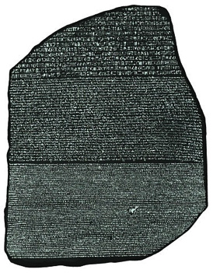
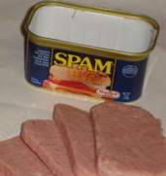

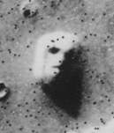
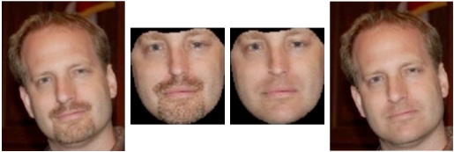

What’s ML Good For?
Photo: Matthew W. Jackson
Photo: Eugene Fratkin
[Nguyen et al., 2008]
Notes:
Weeding out spam, tagging my friends’ faces in iPhoto, machine translation, helicopter flying, and even virtual beard shaving.
Note: The Mona Lisa, Cydonia, and Rosetta Stone images are in the public domain.

Slide 4
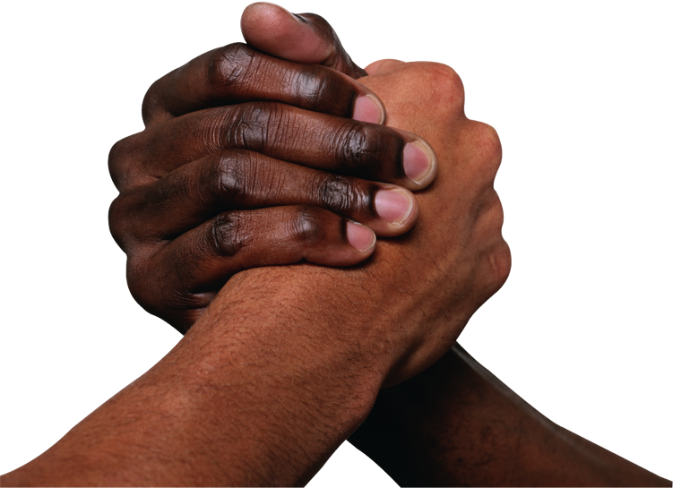
This is not about theory vs. applications
X
This is about
doing something That has an impact
(Theory can too!)

Slide 5
But it could be so much more
How often Are we doing
machine learning for
machine learning’s sake?
Notes:
We just sat through three days of the latest greatest ML results. How many directly addressed a problem of import to the world outside the ML community?

Slide 6
ML Research Trends that Limit Impact
Data sets disconnected from meaning
Metrics disconnected from impact
Lack of follow-through

Slide 7

UCI data sets
“The standard Irvine data sets are used
to determine percent accuracy of concept classification,
without regard to performance on a larger external task.”
But that was way back in 1992, right?
Jaime Carbonell
UCI: Online archive of data sets provided by the University of California, Irvine
[Frank & Asuncion, 2010]
Notes:
Note: Jaime’s picture is from his website, http://www.cs.cmu.edu/~jgc/

Slide 8
UCI Data Sets today

Slide 9



data Sets disconnected from meaning
UCI initially
…
“Each species is identified as definitely edible, definitely poisonous, or of unknown edibility and not recommended. This latter class was combined with the poisonous one.” – UCI Mushroom data set page
3.2 | 1.5 | 2.9
2.6 | 1.8 | 3.1
2.9 | 1.4 | 3.3
1.2 | -3.2 | 8.5
1.8 | -2.7 | 7.9
0.9 | 1.3 | 8.2
0.1 | 0.8 | 4.7
0.3 | 0.7 | 4.9
-0.2 | 0.7 | 5.0
UCI today
…
Did you know that the mushroom data set has 3 classes, not 2?
Have you ever used this knowledge to interpret your results on this data set?
Notes:
The problem is not that we use UCI data. It’s HOW we use the data.
“So what,” you say. “I don’t care what they mean, I just want to compare my algorithm and get numbers out.”
But maintaining the connection with meaning helps 1) keep your work relevant and b) you to understand what your algorithm is doing, its strengths and weaknesses.

Slide 10
Data Sets can be useful benchmarks
Too often, we fail at both goals
Enable direct empirical comparisons with other techniques
  And reproducing others’ results
Easier to interpret results since data set properties are well understood
No standard for reproducibility
We don’t actually understand these data sets
The field doesn’t require any interpretation

Slide 11



Benchmark Results that Matter
Show me:
Data set properties that permit generalization of results
  Does your method work on binary data sets?
  Real-valued features?
  Specific covariance structures?
  Overlapping classes?
OR
How your improvement matters to the originating field
96% accuracy in separating poisonous and edible mushrooms? Not good enough for me to trust it!
4.6% improvement
in detecting
cardiac arrhythmia?
We could save lives!
Notes:
To be clear, the UCI data sets have done a lot of good for the field. But to have impact, show me 1) what general properties of those data sets are relevant, or 2) how your improvement matters to the originating field. Otherwise I haven’t learned anything. The results are anecdotal at best.
Note: mushroom and arrhythmia images from UCI archive data set pages. http://archive.ics.uci.edu/ml/datasets/Mushroom, http://archive.ics.uci.edu/ml/datasets/Arrhythmia

Slide 12
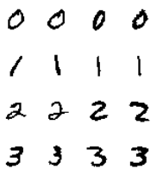
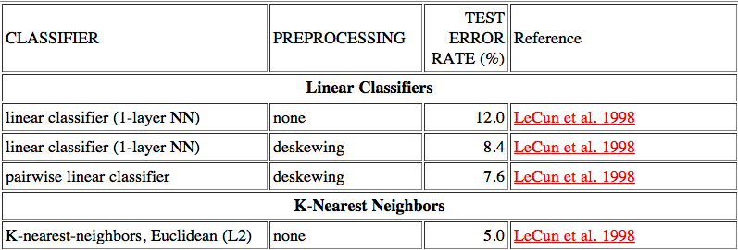
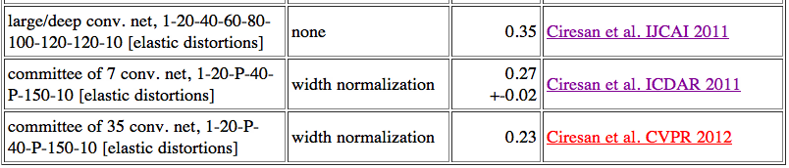
MNIST Handwritten Digits
Does NIST know? Do they care?
[Fieres, 2006]
…
Notes:
Yann LeCun maintains this list of 69 methods and results as a community service.
Is this solved? 0.23% error rate means missing only 23 of 10,000 test items!
Does NIST know? Does NIST care? No – NIST created these data sets in the early 1990’s for the IRS and Census Bureau, to spur innovation in digit recognition. They haven’t actively tracked the field for a decade. The IRS may no longer urgently need this technology due to the rise in e-filing.
Why are we still optimizing it?

Slide 13

2. Metrics Disconnected from Impact
Accuracy, RMSE, precision, recall, F-measure, AUC, …
Deliberately ignore problem-specific details
Cannot tell us
  WHICH items were classified correctly or incorrectly?
  What impact does a 1% change have? (What does it mean?)
  How to compare across problem domains?
This doesn’t mean accuracy, etc. are bad measures,
just that they should not remain abstractions
“A Machine Learning Approach
to the Detection of Fetal Hypoxia during Labor and Delivery”
by Warrick et al., 2010
“The approach we proposed in this paper
detected correctly half of the pathological cases, with acceptable false positive rates (7.5%),
early enough to permit clinical intervention.”
Notes:
Other issues – see ICML 2012 tutorial and book by Japkowicz and Shah on Performance Evaluation.
Another way to put it: a myopic focus on abstract metrics may keep us from seeing the bigger impact.

Slide 14
3. Lack of Follow-Through
ML research program
ML publishing incentives
This is hard!
Notes:
In our review processes and our publications, we almost always stop with the second row.

Slide 15
Making Machine Learning Matter
Employ meaningful evaluation methods
  Direct measurement of impact when possible
  Translate abstract metrics into domain context
Involve the world outside of ML
  Domain experts
  “Comment” papers
Choose problems to tackle biased by expected impact
What is the field’s objective function?

Slide 16
Impact Challenges
Legal decision based on ML analysis
$1B saved from ML decision making
Conflict between nations averted by ML translation
50% reduction in cybersecurity break-ins through ML defenses
Human life saved by diagnosis or intervention recommended by ML
Improvement of 10% in country’s Human Development Index (HDI)
Notes:
We can (and should) quibble about these things. But let’s be mindful and think about what our objective function really is.

Slide 17

Conclusions
ML has had positive impact, and will continue to do so
What changes are needed to increase ML’s impact
and avoid this scenario?
91%
Machine Learning world
Data
89%
83%
76%
?
Notes:
Now is the time to have this conversation, in person, as a community, right now.
Thank you to everyone who’s talked with me about this subject, and for those contributing on the discussion forum at mlimpact.com.

Slide 18
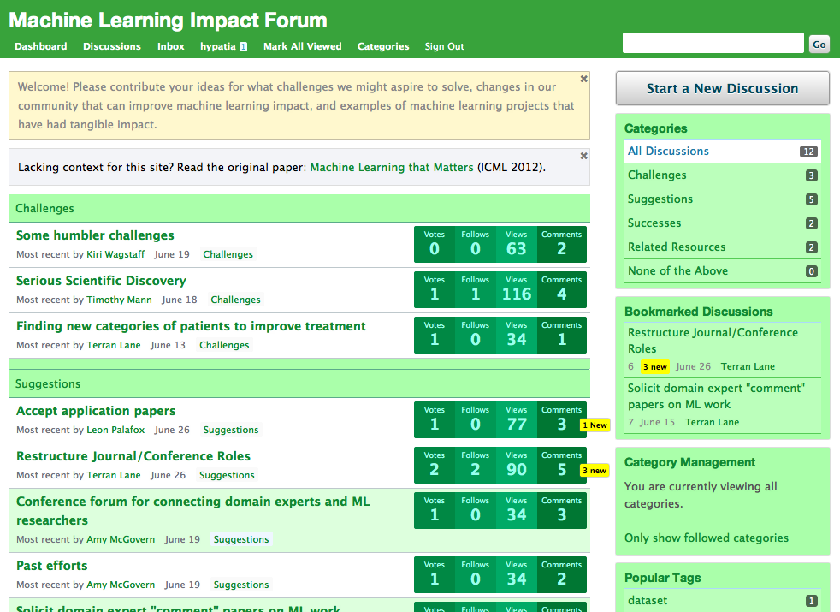
mlimpact.com
http://mlimpact.com/

